Slide 1
PDAT613G: Data Mining
Module 2C – Model Tuning

Slide 2
00 – We’ll look at three fundamental concepts in model-building.
Honest Testing: Never test on the same data that was used to train the model.
Model Tuning: Choosing the right model complexity gives better predictive power.
Data Preprocessing: Preprocessing the data is not separate from the modeling workflow.
Notes:
In the last two modules, we’ve seen an overview of several machine learning techniques. We’ve looked an high-level descriptions of how they work and some commands to run those methods in R. Those single commands are only the beginning of the workflow that surrounds the creation of these models. In this module, we’ll look at three over-arching themes that apply in almost all modeling settings. The details may differ from one setting to another, but it’s always important to consider these concepts. First, we’ll look at the importance of “honest testing.” We’ve already seen this idea in the creation of training and test sets, but now we’ll discuss resampling and cross-validation. Second, we’ll look at model tuning. How do we tune a model’s complexity to match the structure of the data and give better predictive power. Third, we’ll touch on the problem of data preprocessing and how it integrates with the modeling workflow. We’ll look at how to implement these ideas in R with the tidymodels package. Although there’s more out there than we’ll be able to cover in this module, I hope that you’ll get a good idea of what to look for when starting a modeling project, and where to look for answers.

Slide 3
“Honest Testing” of Models

Slide 4
01 – “Honest Testing” is always important.
Goal: We want to know how well a model will do in making novel predictions.
Problem: A model might simply “memorize” the training data.
Solution: Never test a model’s accuracy with the same data used to create the model.
Training set: About 70% of the data set. Used to create the model.
Test set: About 30% of the data set. Used to test the model.
Notes:
We’ve looked at the problem of honest testing before. Because machine learning models can be so flexible, there’s always the danger that they’ll learn the training set too well. That’s the problem of overfitting. We want a model that can make good predictions on new data, not one that has simply memorized all the data used to train it. The most basic solution to this problem is to separate the available data into a training set, used to actually create the model, and a test set, used to validate the model’s accuracy. There’s no hard and fast rule, but a 70/30 split between training and testing is a good rule of thumb. You might see 75/25 or other ratios as well. It is important to have enough data in the test set, which can be an issue if you don’t start out with a lot of data.

Slide 5
02 – “Honest Testing” is always important.
Goal: We want to know how well a model will do in making novel predictions.
Problem: A model might simply “memorize” the training data.
Solution: Never test a model’s accuracy with the same data used to create the model.
Training set: About 70% of the data set. Used to create the model.
Test set: About 30% of the data set. Used to test the model.
Problem: A single test result may not be reliable. What if your test set happened to be “easy-to-predict,” just by chance?
Notes:
One problem with this simple scenario is that a single test set only gives one measure of the model’s accuracy. This single measure is vulnerable to the random chance that selects the test set. I’ve seen this happen. In one modeling contest I took part in, one of the other students was getting accuracies I couldn’t beat on every model he ran. Then, when it came time to assess the models on absolutely new data, his model fell back into the crowd, and I edged ahead of him. He’d been measuring all his models against one test set, and that set, through random chance, didn’t contain any of the hardest-to-predict points. I’d been using cross-validation (which we’ll look at next), and my accuracies stayed relatively unchanged in the final model evaluation.

Slide 6
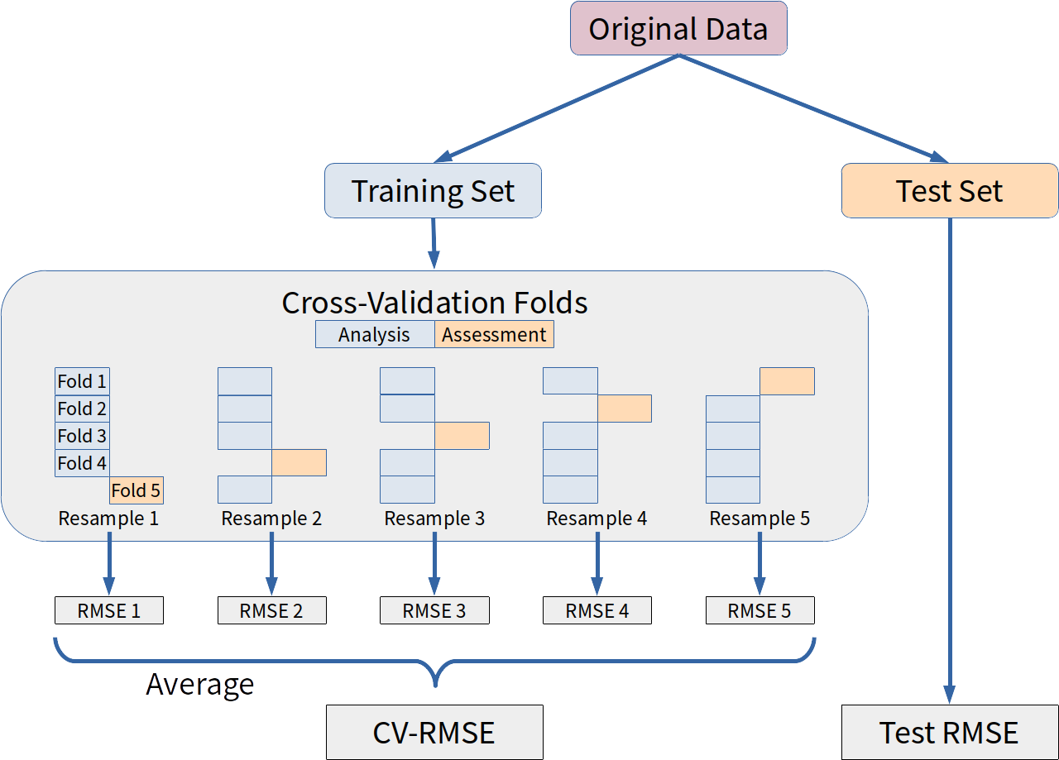
03 – Cross-validation creates many “analysis” and “assessment” sets from the same data set.
Notes:
The idea behind cross-validation, and the methods of “resampling” more generally, is that you will create many models, and many assessments of the model, from the same data set. To keep the terminology clear, we’ll continue to use “training” and “test” sets to refer to the simpler scenario we described on the last slide. In cross-validation (and resampling), we’ll talk about dividing the training set into multiple “analysis” and “assessment” sets. Each analysis set will be used to create a model, and each assessment set will be used to test that model. More specifically, the method of k-fold cross-validation divides the data into “folds,” each of which is 1/k of the total. The diagram shows 5-fold cross-validation, but in practice 10-fold is common. Many models are created, each time holding one fold out as an assessment set, while using the remaining folds to create the model. For each model created in this way, an error estimate is created. I’ve shown root-mean-squared error in the diagram, which is appropriate for regression problems (prediction of numeric values), but the error measure could be any appropriate measure of error or accuracy, depending on the problem. Then each of these individual error estimates is averaged to get a single “cross-validated” error estimate. This cross-validated error estimate should be an “honest” assessment of the model, on par with what you’d get from the simpler training/test set set-up. Note, however, that none of the cross-validation models that are created are actually your final model. Once the cross-validated error estimate is calculated, a final model is created using all the training data. In essence, the cross-validated error estimate is assessing how models of this type perform on data like the data you have, but is not directly assessing the actual final model created from the whole set. That’s OK, and cross-validation works very well in practice.

Slide 7
04 – Cross-validation generally creates a more reliable error estimate, but adds complexity.
Single Test Set
Create one model with training data. Test on test set.
Error estimate varies with the random choice of test set.
Cross-Validation
Creates one model and one error estimate for each resampling.
Averages the error estimates, which gives a final error estimate with less variance.
A final model is then created using the whole training set.
Note: Other forms of resampling include bootstrapping and out-of-bag error estimation, but they have similar pros/cons.

Slide 8
Model Tuning

Slide 9
05 – Model tuning often gives greater predictive power.
It’s helpful to think of families of models: linear regression, random forests, support vector machines, etc.
A final fitted model is found by
choosing a model family,
choosing a set of hyper-parameters to pick a specific model from the family,
fitting the model to a set of data.
Tuning the model refers to choosing the right set of hyper-parameters to give a good model with your data.
Which hyper-parameters do you vary?
How do you measure when the model is good?

Slide 10
06 – Hyper-parameters are often controls on model complexity.
If a model is too simple, it won’t predict anything well.
If a model is too complex, it “memorizes” the training data and does worse in making new predictions.
(We hope) There is an optimal hyper-parameter value that gives the best predictive power on new data.

Slide 11
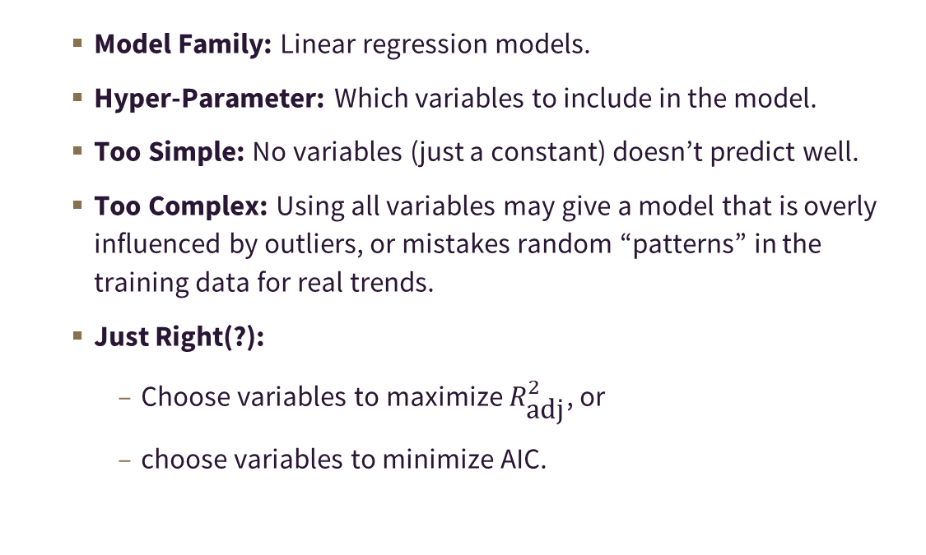
07 – Variable selection is a way of tuning linear regression models.
Model Family: Linear regression models.
Hyper-Parameter: Which variables to include in the model.
Too Simple: No variables (just a constant) doesn’t predict well.
Too Complex: Using all variables may give a model that is overly influenced by outliers, or mistakes random “patterns” in the training data for real trends.
Just Right(?):
Choose variables to maximize $R_{\text{adj}}^{2}$, or
choose variables to minimize AIC.

Slide 12
08 – Decision trees have hyper-parameters that determine when to split nodes and when to stop.
Model Family: CART models.
Hyper-Parameters:
cost_complexity: Complicated, but says “the tree’s fit must increase by this much to split this node.”
tree_depth: Stop after this many splits down from the root node.
min_n: A node must have this many observations in it to be split further.
Too Simple: Set tree_depth=0 and you get just a stump.
Too complicated: Set min_n=1 and you might get every observation in its own final node (just replicating the data set).

Slide 13
09 – Cross-validation (and other resampling techniques) help find the best hyper-parameters.
Divide the data set into training and test sets (a test set isn’t mandatory, but often done).
Create a list of hyper-parameters to test.
A regular search grid is often used.
Sometimes hyper-parameters are chosen randomly.
For each set of hyper-parameters, use cross-validation to calculate the cross-validated error measure for that choice.
Choose the hyper-parameters that give the lowest error.
Use the entire training set to calculate the final model using your “best” hyper-parameter choice.
Do a final test of error/accuracy with your test set?

Slide 14
The Data-Processing Pipeline

Slide 15
10 – Suppose your model requires all variables to be standardized. What’s wrong with this workflow?
Start with the original data frame.
Subtract the mean from all variables.
Divide each variable by its standard deviation.
Separate the data set into a training and test set.
Fit the model with the training set.
Evaluate the model with the test set.

Slide 16
11 – Suppose your model requires all variables to be standardized. What’s wrong with this workflow?
Start with the original data frame.
Subtract the mean from all variables.
Divide each variable by its standard deviation.
Separate the data set into a training and test set.
Fit the model with the training set.
Evaluate the model with the test set.
Information from data that will end up in the test set is contributing to the mean and standard deviation, which are used to transform data that ends up in the training set.
Performance on the test set is no longer an honest assessment of how well the model will do with new data.

Slide 17
12 – The data-processing pipeline can’t be separated from the modeling workflow.
Separate the data set into a training and test set.
Model Fitting
For each variable in the training set, subtract its mean (calculated from the training set alone).
Divide each variable in the training set by its standard deviation (calculated from the training set alone).
Fit the model with the training set.
Model Prediction
For each variable in the test set, subtract the mean remembered from the training set.
Divide each variable in the test set by the standard deviation remembered from the training set.
Evaluate the model using the transformed test set.
This becomes more complicated with cross-validation.
It would be great for software to do this for us.

Slide 18
Model Tuning in R with tidymodels

Slide 19
13 – R offers the caret and tidymodels packages to automate and standardize model-making.
Both attempt to unify the syntax of disparate individual modeling packages in R.
Both automate cross-validation and other forms of resampling.
caret: A package to streamline the creation of models.
Stable and more well-established.
Uses a syntax that doesn’t always play well with data frames.
tidy models: Group of several packages from the tidyverse people.
Designed to work better with tidyverse workflows.
Newer, more similar to Python’s scikit-learn

Slide 20
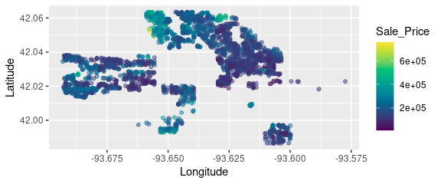
14 – Example: Predicting Housing Costs using Location
library(tidyverse); library(tidymodels); library(AmesHousing) library(colorspace) ames <- make_ames() %>% select(Sale_Price, Latitude, Longitude) ggplot(ames, aes(x=Longitude, y=Latitude, color=Sale_Price)) + geom_point(alpha=0.5) + scale_color_continuous_sequential(palette="Viridis", rev=FALSE)

Slide 21
15 – Create the test and training sets.
set.seed(387) # Functions from the 'rsample' package. ames.rsplit <- initial_split(ames, prop=0.70) ames.rsplit
<Analysis/Assess/Total> <2051/879/2930>
ames.train <- training(ames.rsplit) ames.test <- testing(ames.rsplit)

Slide 22
16 – A simple fit using linear regression…
# Commands from the 'parsnip' package. # First create the model specification. lm.model_spec <- linear_reg() %>% set_engine("lm")
# Then create the fitted model. lm.model_fit <- lm.model_spec %>% fit(Sale_Price ~ ., data=ames.train)

Slide 23
17 – Linear Regression Output
lm.model_fit
parsnip model object Fit time: 5ms Call: stats::lm(formula = formula, data = data) Coefficients: (Intercept) Latitude Longitude -1.28e+08 1.27e+06 -7.99e+05

Slide 24
18 – The underlying ‘lm’ object can be accessed via ‘$fit’.
summary(lm.model_fit$fit)
Call: stats::lm(formula = formula, data = data) Residuals: Min 1Q Median 3Q Max -143710 -46472 -19385 31415 541028 Coefficients: Estimate Std. Error t value Pr(>|t|) (Intercept) -1.28e+08 7.13e+06 -17.9 <2e-16 *** Latitude 1.27e+06 8.89e+04 14.3 <2e-16 *** Longitude -7.99e+05 6.31e+04 -12.7 <2e-16 *** --- Signif. codes: 0 '***' 0.001 '**' 0.01 '*' 0.05 '.' 0.1 ' ' 1 Residual standard error: 73600 on 2048 degrees of freedom Multiple R-squared: 0.145, Adjusted R-squared: 0.145 F-statistic: 174 on 2 and 2048 DF, p-value: <2e-16

Slide 25
19 – Evaluating the model using predict and rmse.
head(predict(lm.model_fit, new_data=ames.test), 3)
# A tibble: 3 x 1 .pred <dbl> 1 186617. 2 181136. 3 206062.
# This 'rmse' comes from the 'yardstick' package. Takes a data # frame as input, with truth and estimate specifying columns. predict(lm.model_fit, new_data=ames.test) %>% bind_cols(ames.test) %>% rmse(truth=Sale_Price, estimate=.pred)
# A tibble: 1 x 3 .metric .estimator .estimate <chr> <chr> <dbl> 1 rmse standard 73521.

Slide 26
20 – How well can a decision tree fit the data?
# Note that a tree can do regression or classification, # so we specify a mode. Here we string the model_spec # and fit together. tree.model_fit <- decision_tree() %>% set_engine("rpart") %>% set_mode("regression") %>% fit(Sale_Price ~ ., data=ames.train) predict(tree.model_fit, new_data=ames.test) %>% bind_cols(ames.test) %>% rmse(truth=Sale_Price, estimate=.pred)
# A tibble: 1 x 3 .metric .estimator .estimate <chr> <chr> <dbl> 1 rmse standard 55673.

Slide 27
21 – To tune a model, leave tune() placeholders in the model spec.
tree.tune.model_spec <- decision_tree( cost_complexity=tune(), tree_depth=tune() ) %>% set_engine("rpart") %>% set_mode("regression")

Slide 28
22 – We can set up cross-validation using more commands from the rsample package.
# From the rsample package. 10 folds is the default. ames.folds <- vfold_cv(ames.train) ames.folds
# 10-fold cross-validation # A tibble: 10 x 2 splits id <list> <chr> 1 <split [1.8K/206]> Fold01 2 <split [1.8K/205]> Fold02 3 <split [1.8K/205]> Fold03 4 <split [1.8K/205]> Fold04 5 <split [1.8K/205]> Fold05 6 <split [1.8K/205]> Fold06 7 <split [1.8K/205]> Fold07 8 <split [1.8K/205]> Fold08 9 <split [1.8K/205]> Fold09 10 <split [1.8K/205]> Fold10

Slide 29
23 – Next we set up the grid of tuning parameters.
# These commands come from the 'dials' package. # The 'cost_complexity()' and 'tree_depth()' commands supply default values. tree.grid <- grid_regular(cost_complexity(), tree_depth(), levels=5) head(tree.grid, 10)
# A tibble: 10 x 2 cost_complexity tree_depth <dbl> <int> 1 0.0000000001 1 2 0.0000000178 1 3 0.00000316 1 4 0.000562 1 5 0.1 1 6 0.0000000001 4 7 0.0000000178 4 8 0.00000316 4 9 0.000562 4 10 0.1 4

Slide 30
24 – Now evaluate the model with different parameters, using cross-validation.
# Commands from the 'tune' package. tree.tune_results <- tree.tune.model_spec %>% tune_grid(Sale_Price ~ Latitude + Longitude, resamples=ames.folds, grid=tree.grid) tree.tune_results %>% collect_metrics() %>% head()
# A tibble: 6 x 7 cost_complexity tree_depth .metric .estimator mean n std_err <dbl> <int> <chr> <chr> <dbl> <int> <dbl> 1 0.0000000001 1 rmse standard 71604. 10 1981. 2 0.0000000001 1 rsq standard 0.188 10 0.0119 3 0.0000000001 4 rmse standard 57611. 10 1646. 4 0.0000000001 4 rsq standard 0.474 10 0.0222 5 0.0000000001 8 rmse standard 50038. 10 2234. 6 0.0000000001 8 rsq standard 0.603 10 0.0288

Slide 31
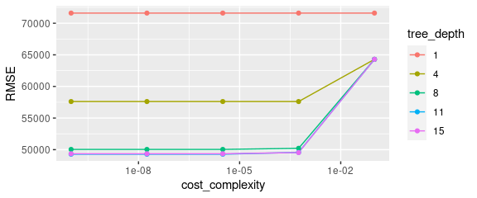
25 – A graph can illustrate tuning parameters more clearly.
tree.tune_results %>% collect_metrics %>% filter(.metric == "rmse") %>% mutate(tree_depth = factor(tree_depth)) %>% ggplot(aes(x=cost_complexity, y=mean, color=tree_depth)) + geom_line() + geom_point() + ylab("RMSE") + scale_x_log10()

Slide 32
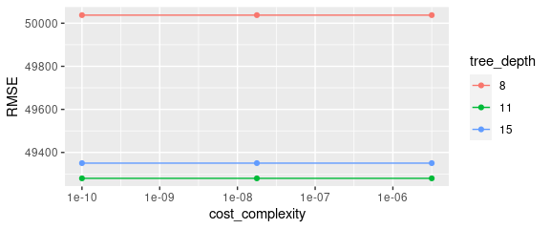
26 – Let’s zoom in. “Computer, enhance image.”
tree.tune_results %>% collect_metrics %>% filter(.metric == "rmse", tree_depth >= 8, cost_complexity < 0.00001) %>% mutate(tree_depth = factor(tree_depth)) %>% ggplot(aes(x=cost_complexity, y=mean, color=tree_depth)) + geom_line() + geom_point() + ylab("RMSE") + scale_x_log10()

Slide 33
27 – We can show the best model and “finalize” to fit the best model.
# Commands are again from the 'tune' package. tree.tune_results %>% show_best(metric="rmse")
# A tibble: 5 x 7 cost_complexity tree_depth .metric .estimator mean n std_err <dbl> <int> <chr> <chr> <dbl> <int> <dbl> 1 0.0000000001 11 rmse standard 49280. 10 2270. 2 0.0000000178 11 rmse standard 49280. 10 2270. 3 0.00000316 11 rmse standard 49280. 10 2270. 4 0.0000000001 15 rmse standard 49350. 10 2229. 5 0.0000000178 15 rmse standard 49350. 10 2229.
tree.best.params <- tree.tune_results %>% select_best(metric="rmse") tree.best.model_fit <- tree.tune.model_spec %>% finalize_model(tree.best.params) %>% # Gives a model_spec fit(Sale_Price ~ ., data=ames.train) # Gives a model_fit

Slide 34
28 – How well does the tuned model do?
predict(lm.model_fit, new_data = ames.test) %>% bind_cols(ames.test) %>% rmse(truth=Sale_Price, estimate=.pred)
# A tibble: 1 x 3 .metric .estimator .estimate <chr> <chr> <dbl> 1 rmse standard 73521.
predict(tree.model_fit, new_data = ames.test) %>% bind_cols(ames.test) %>% rmse(truth=Sale_Price, estimate=.pred)
# A tibble: 1 x 3 .metric .estimator .estimate <chr> <chr> <dbl> 1 rmse standard 55673.
predict(tree.best.model_fit, new_data = ames.test) %>% bind_cols(ames.test) %>% rmse(truth=Sale_Price, estimate=.pred)
# A tibble: 1 x 3 .metric .estimator .estimate <chr> <chr> <dbl> 1 rmse standard 45633.

Slide 35
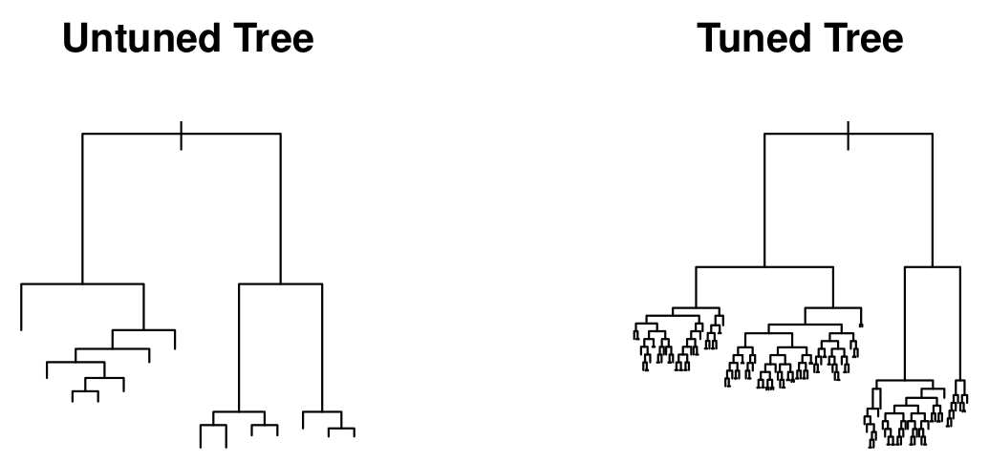
29 – A comparison of tuned and untuned trees.
par(mfrow=c(1,2))
plot(tree.model_fit$fit, main="Untuned Tree")
plot(tree.best.model_fit$fit, main="Tuned Tree")

Slide 36
30 – Graphing the tuned model, just for fun.
# Create a grid of latitude and longitude points.
lat <- seq(min(ames$Latitude), max(ames$Latitude), length.out=500) long <- seq(min(ames$Longitude), max(ames$Longitude), length.out=500) lat.long.grid <- expand.grid(Longitude=long, Latitude=lat)
# Plot predictions as regions. predict(tree.best.model_fit, new_data = lat.long.grid) %>% bind_cols(lat.long.grid) %>% ggplot(aes(x=Longitude, y=Latitude)) + geom_raster(aes(fill=.pred), alpha=0.5) + geom_point(data=ames, aes(color=Sale_Price), alpha=0.5, size=1) + scale_color_continuous_sequential(palette="Viridis", rev=FALSE) + scale_fill_continuous_sequential(palette="Viridis", rev=FALSE) + theme_bw()

Slide 37
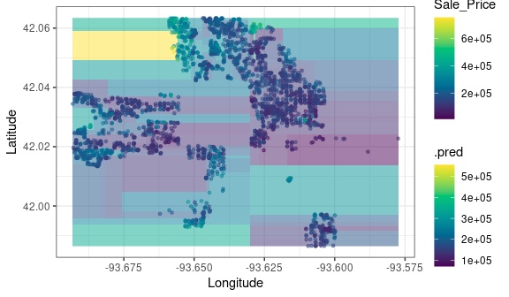
31 – Graphing the tuned model, just for fun.

Slide 38
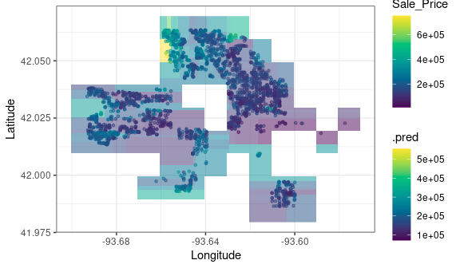
32 – A better graph would leave out non-residential regions.

Slide 39
33 – Further Steps
The Tidymodels web site (tidymodels.org) has more information, including a series of five tutorials (tidymodels.org). The examples used in these notes presented a simplified version of some of that information.
You can use recipes to encode common data pre-processing steps.
Workflows join recipes with model specifications.
This stuff might seem complicated, but once you’ve had to code all these steps “by hand,” the package commands are a life-saver!

